Slide 1
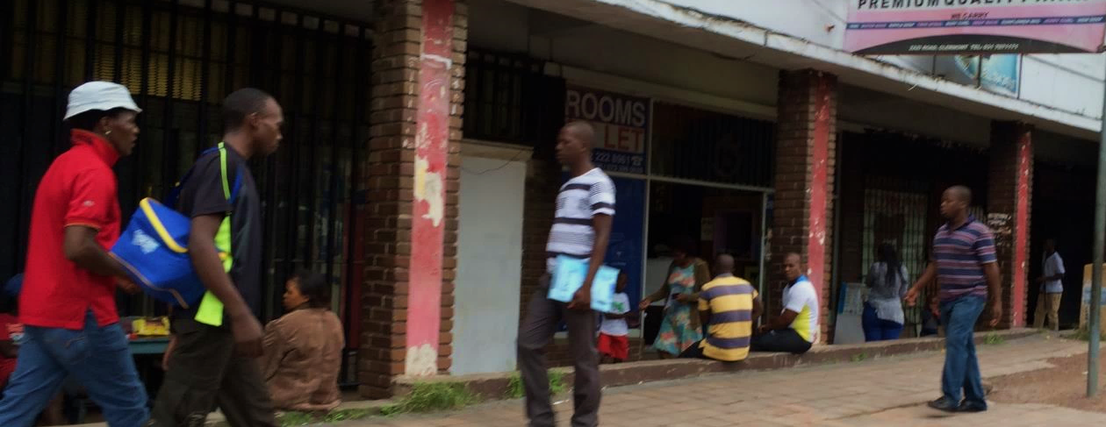
Men’s HIV Risk Profiles in South African DREAMS Sites
Using latent class analysis for more strategic, context-specific programming and evaluation
Ann Gottert, PhD
Co-authors: Julie Pulerwitz, ScD, Craig Heck, MPH
Cherie Cawood, MBA & Sanyukta Mathur, DrPH
International AIDS Conference
25 July 2018

Slide 2
Background
Critical need to reach more men with HIV prevention and treatment services
  Lower testing and treatment uptake than women
  Higher morbidity and mortality than women
Intensified efforts to reach men at highest risk of acquiring and transmitting HIV
Recent focus on male partners of adolescent girls and young women (AGYW)
  DREAMS Partnership
Requires a context-specific understanding of groups of men most at risk, to inform differentiated programming and evaluation

Slide 3
Latent Class Analysis (LCA)
LCA can generate sophisticated, data-driven profiles
  Way to uncover hidden groupings in data
  (“latent classes”)
  Can include demographics, attitudinal and behavioral indicators
Builds on benefits of other quantitative and qualitative approaches
  Opportunity to develop complex picture using large sample
Rarely applied in HIV prevention in LMIC

Slide 4
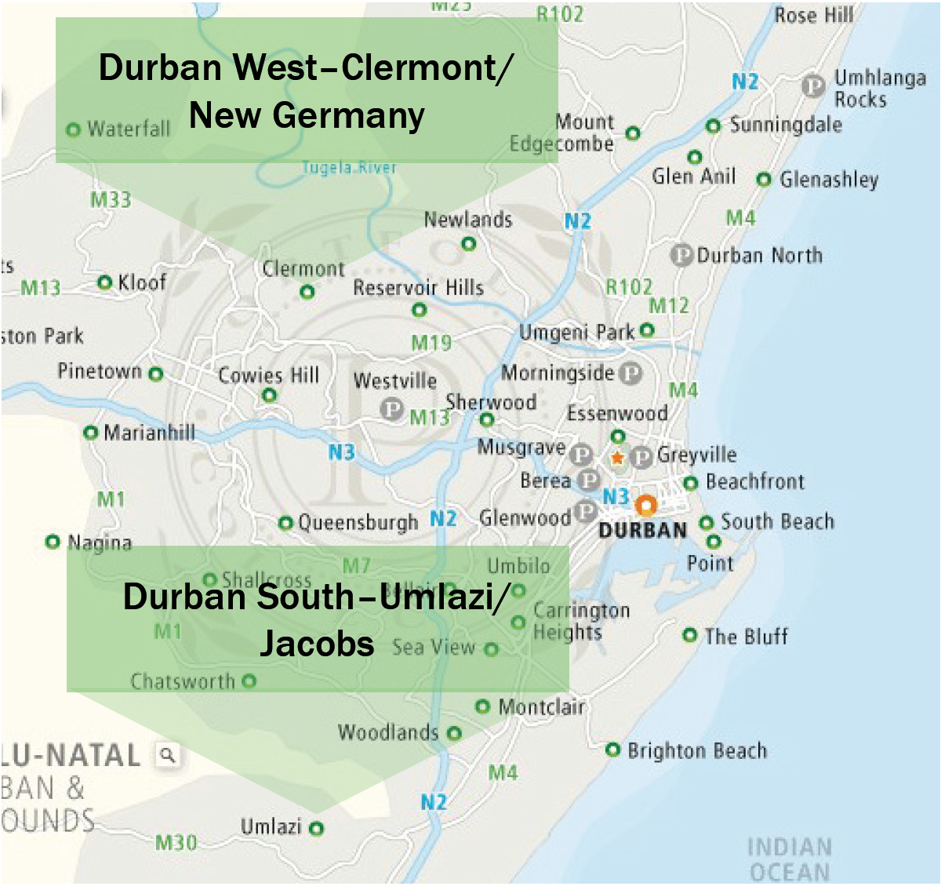
Study setting
Durban, South Africa
Survey with 962 men ages 20-40 years old
2 informal settlements where DREAMS implemented
Community venues & HIV service sites
May-Sept 2017

Slide 5
Who are the men?
 | N=962
Age (mean) | 28 years
Married/cohabiting | 16%
Education
Some secondary or less | 23%
Secondary | 56%
University/technical college | 21%
Occupation
Unemployed | 39%
Tax/bus driver | 25%
Factory/construction worker | 8%
Service industry | 7%
Other | 11%

Slide 6
What are men’s relationships like?
 | N=962
Number of sexual partners (in the last year)
0-1 | 29%
2-4 | 47%
5+ | 24%
Transactional relationships
None | 44%
Low-end (e.g., paying for partner’s meal) | 44%
High-end (e.g., paying for partner’s rent) | 12%
Endorsement of highly inequitable gender norms | 25%

Slide 7




HIV risk profiles
YOUNGER
MODERATE
RISK
36%
of sample
OLDER
LOW
RISK
20%
of sample
YOUNGER
HIGH
RISK
24%
of sample
OLDER
HIGH
RISK
20%
of sample

Slide 8
HIV risk profiles
YOUNGER
MODERATE
RISK
36%
of sample
YOUNGER
HIGH
RISK
24%
of sample
OLDER
LOW
RISK
20%
of sample
OLDER
HIGH
RISK
20%
of sample
23 years old
Unmarried
Unemployed, despite being university/ tech college grads
High # of partners
Low age difference
Some transactional relationships
Moderate alcohol abuse
Moderate gender inequity

Slide 9
HIV risk profiles
YOUNGER
MODERATE
RISK
36%
of sample
YOUNGER
HIGH
RISK
24%
of sample
OLDER
LOW
RISK
20%
of sample
OLDER
HIGH
RISK
20%
of sample
23 years old | 27 years old
Unmarried | Unmarried
Unemployed, despite being university/ tech college grads | Informally employed
High # of partners | High # of partners
Low age difference | High age difference
Some transactional relationships | Many low-end transact. relationships
Moderate alcohol abuse | High alcohol abuse
Moderate gender inequity | High gender inequity

Slide 10
HIV risk profiles
YOUNGER
MODERATE
RISK
36%
of sample
YOUNGER
HIGH
RISK
24%
of sample
OLDER
LOW
RISK
20%
of sample
OLDER
HIGH
RISK
20%
of sample
23 years old | 27 years old | 30 years old
Unmarried | Unmarried | Married
Unemployed, despite being university/ tech college grads | Informally employed | Informally employed
High # of partners | High # of partners | Low # of partners
Low age difference | High age difference | Moderate age difference
Some transactional relationships | Many low-end transact. relationships | Minimal transactional relationships
Moderate alcohol abuse | High alcohol abuse | Moderate alcohol abuse
Moderate gender inequity | High gender inequity | Low gender inequity

Slide 11
HIV risk profiles
YOUNGER
MODERATE
RISK
36%
of sample
YOUNGER
HIGH
RISK
24%
of sample
OLDER
LOW
RISK
20%
of sample
OLDER
HIGH
RISK
20%
of sample
23 years old | 27 years old | 30 years old | 36 years old
Unmarried | Unmarried | Married | Married/cohabitating
Unemployed, despite being university/ tech college grads | Informally employed | Informally employed | Informally/formally employed
High # of partners | High # of partners | Low # of partners | High # of partners
Low age difference | High age difference | Moderate age difference | High age difference
Some transactional relationships | Many low-end transact. relationships | Minimal transactional relationships | Many high-end transact. relationships
Moderate alcohol abuse | High alcohol abuse | Moderate alcohol abuse | High alcohol abuse
Moderate gender inequity | High gender inequity | Low gender inequity | Moderate gender inequity

Slide 12
A closer look…
Younger high risk = high number of partners
5+ sexual partners in the last year

Slide 13
A closer look…
Older high risk = most age-disparate partners
Man’s age (mean)
Age of last 3 partners (mean)

Slide 14
A closer look…
Highest-risk group = most gender-inequitable
Endorsement of highly inequitable gender norms

Slide 15
HIV outcomes
Higher-risk classes were less likely, or no more likely, than the lower-risk classes to use HIV services
 | Younger moderate risk | Younger high risk | Older low risk | Older high risk
Received VMMC in last 5 years*** | 42.6% | 18.8% | 13.1% | 8.6%
HIV treatment literacy score (range 0-5)** | 3.57 | 3.36 | 3.70 | 3.57
Tested for HIV in last 12 months | 74.7% | 69.6% | 67.4% | 70.2%
Currently taking antiretroviral therapy (n=84) | 90.0% | 89.5% | 94.7% | 90.6%
**p<0.01, ***p<0.001

Slide 16
Implications
Differentiated programming, tailored to the context
Monitoring program outcomes by latent class membership
  Track HIV testing, VMMC, treatment uptake
Evaluating intervention impact by latent class membership
  Round 2 survey underway to evaluate intensified service outreach to male partners of AGYW, via DREAMS… stay tuned!

Slide 17
Acknowledgments
Funding support: Bill & Melinda Gates Foundation
Local research partner: Epicentre
With support and collaboration from:
  South African Department of Health
  South African National AIDS Council (SANAC)
  eThekwini Municipality
  PEPFAR-South Africa
  DREAMS Implementing Partners

